Slide 1
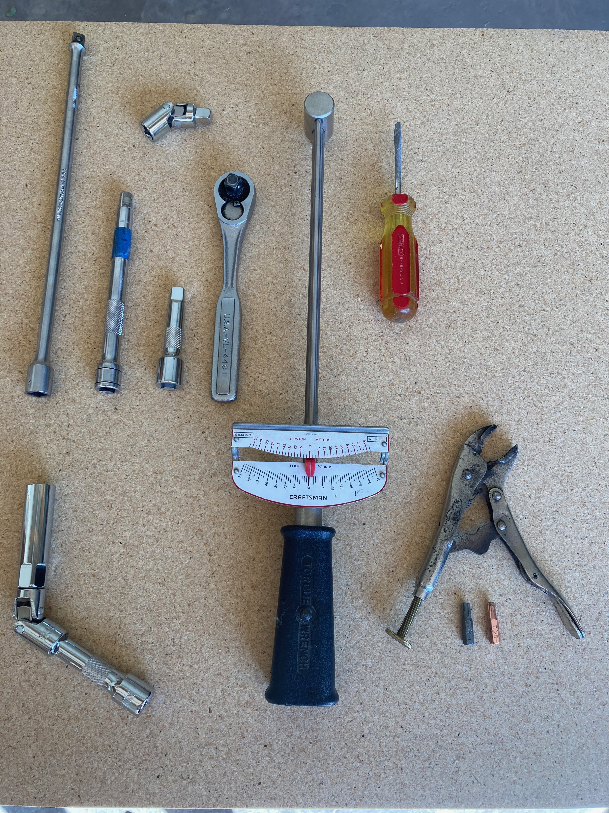
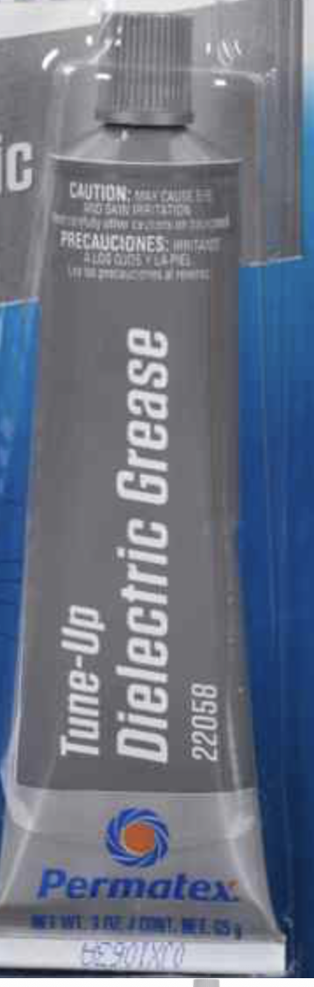
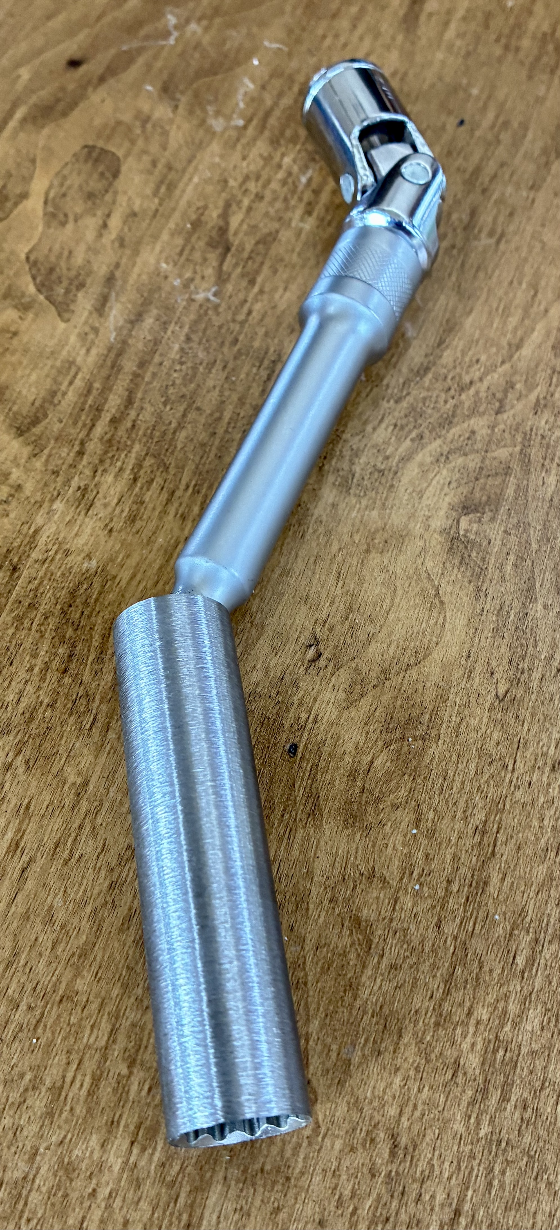

Spyderman2 Socket Tool
(read before using)
These instructions are based 718 Spyder, GTS and GT4. RS vehicles may be slightly different. For the overall job you’ll need a variety of standard tools in addition to this custom socket tool. These include a car jack, flathead screw drivers, torque wrench, T-25 and T-30 screw bits, etc. (stuff you probably have already). I found a small vice-grips also helped to grab the T-25 and T-30 bits to maneuver into tight places to remove fasteners. To R/R the spark plugs, you’ll also need a socket ratchet, plus (shown at right) a variety of socket extensions (3”, 6”, and 12” recommended). These will attach to the custom socket tool and allow you to snake through some pretty torturous access paths to get to the plugs. You should also get some dielectric grease (available at any auto parts store). Each plug has a somewhat different access situation and varying degrees-of-difficulty, but if you have these standard tools and my custom socket tool you’ll be set.
Before using the socket tool to remove or install plugs, insert a new plug into it and get a sense for what it feels like when the socket female hex fully engages the male hex on the plug and is held in by the magnet. You’ll want to do as much of the installation and removal of plugs as possible using just the custom socket tool and screwing in/out by hand. This will minimize chance of cross-threading or other damage. Save the extensions and wrenches for just the initial breakaway torquing when removing plugs, and just the final torquing when installing plugs. Make sure the custom socket tool hex is fully engaged (by hand) on the plug hex before and while applying torque with wrenches.
Hints: You can save yourself some time and effort by doing spark plug change at the same time as oil change because both require jacking up car, removing underbody panels, etc.
Buy spark plugs from Suncoastparts.com (SKU: SKU718GTPLUGS, for non-RS, identical to OEM plugs)
Access is tight in there, but with the right tools and a little patience you’ll get’er done. See step-by-step procedure on the back. I suggest briefly reading the entire procedure before starting. Also, I highly recommend watching the great video available here on how to plugs on 718 4.0 engines:
https://www.jetfuelgarage.com/youtube
Congrats in advance on accomplishing this job.

Slide 2
Spyderman’s 718 Spyder Spark Plug Change Procedure
Jack up entire car if possible (I used a QuickJack). If you only jack up 1 tire at a time you may skip Step 2.
I did the following underbody panel removals because I was also changing the oil. It made access to the plugs easier. You can also do it without removing these underbody panels, but access is slightly more difficult.
Remove lug bolts and one of the rear wheels/tires. Most lug bolts require a 19 mm socket. Each tire has one lug bolt with a special head. The tool to engage that head can be found in the OEM tool kit in the frunk.
Remove the plastic shield just fwd of the wheel in the wheel well – (qty 2) 10 mm nuts & (qty 4) T-25 and/or T-30 screws, one of which is on the underside.
Remove the shiny heat shield/cover (forward and inboard of the wheel) that hide the spark plugs - (qty 3) T-30 screws. Note that there is an upper and a lower shield, but you only need to remove the upper. Leave the lower in place. After you get the 3 screws out and as you start to remove the heat shield you’ll notice it is connected via 2 clips to a wire hidden behind it. Simply push the wire upwards next to the two clips and the shield will come free of the wire and can be removed.
You can cut up your hands pretty bad doing this next part, mainly because there is a surface just a few inches outboard of the Spark Plug/Ignition coil boots that has a surface coating that has a very sharp/rough texture. Some people recommended gloves, but I found gloves to be too restricting to maneuver my hands in the tight areas. Others recommended sanding off the rough areas. I simply covered the area with a few pieces of duct tape, and that saved some blood while doing the passenger’s side. I got many small cuts doing the driver’s side (first). Remember to remove the tape at the end.
There is a T-30 head screw securing each of the three Spark Plug/Ignition coil boots on each side of the engine. Untorque the screw until you can turn it by hand, then keep unscrewing it until it suddenly pulls out ¼ to ½ inch. It will then be completely out of the hole threads but remain captured by the boot. If you keep unscrewing after it pulls out it can become loose of the boot and can be lost.
Pull (wiggle back and forth and pull firmly) the coil boot outward and off the spark plug. Leave it connected to the electrical harness, and push it out of the way. This should give you adequate access to the spark plug, and if so you can skip steps 9 and 10. If you want or need to detach the coil from the harness for better access, or to change the coils also, perform steps 9 and 10.
Unplug the boot connector. To do this, use a small flathead screwdriver to push the yellow clip in the forward direction until it clicks forward. Then push in on the black clip that is just aft of the yellow clip and wiggle back and forth and pull firmly to separate the connector. This is probably the hardest part of the entire process, and it can take a bit of finesse to get the plug to come apart.
Remove the Spark Plug/Ignition coil boot – after it is unplugged from the boot connector it should pull out easily.
Use my socket tool with extensions as required to untorque and remove spark plug. A few notes on this:
  The spark plug is deep in the hole. When the socket engages the plug hex, the inboard socket face will be ~ 5” inboard from the outer edge of the hole.
  There are lots of threads on the plug to unscrew (look at one of your new plugs to see how many). Unscrew by hand after breaking free so you can tactilely feel when the threads are out of the hole. Pull the plug out carefully so it stays in the socket on its way out.
  The outer wall of the hole is not in straight alignment with the axis of the plug, hence the need for a swivel.
Add a small amount of dielectric grease to the white cylindrical part of the new spark plug. I just put on a very thin layer of standard dielectric grease. Note – I bought new plugs from Suncoastparts.com. Gaps came preset. You can get dielectric grease from any auto parts store.
Install the new plug. Torque to 15 N-M (11 ft-lbs) for non-RS plugs. RS plugs have larger threads so larger torque is appropriate. I could not find exact spec value but suggest 23 N-M ( 17 ft-lbs). RS users should confirm.
Reinstall ignition coil boot and screw. I just snugged it but specified torque is 10 N-M (7 ft-lbs).
Repeat 5 more times on other plugs.
When reinstalling Heat shield, remember to reattach the wire to the clips on backside of heat shield.
When reinstalling Heat shield screws, I just snugged them but specified torque is 3.5 N-M (2.6 ft-lbs)
Remember to remove any tape you may have added to protect your hands. Reinstall removed shields.
After you get all the plugs done and wheels back on, pat yourself on the back for a job well done!

